Slide 1

Fine Wining
Group Project 2
By
Daniel Budhram
Austin Rodriguez
Gregg Saldutti
Rochelle Williams

Slide 2
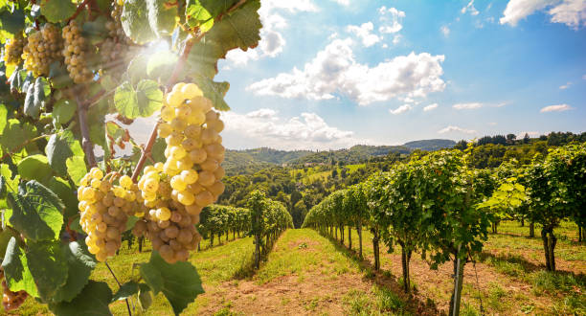
Project Concept
Conduct an analysis on red and white Vinho Verde from the northern region of Portugal.
Use machine learning and deep learning techniques to conduct a statistical analysis of the data.

Slide 3
Data & Process
We used data sets from Kaggle (University of California Irvine)
Winequality – Red
Winequality – White
We decided to conduct various regression, classification & Neural Network models

Slide 4

qualities of Red & white wines based on the following
Fixed Acidity - Primary fixed acids found in wine are tartic, succinic, citric and malic
Volatile Acidity - Volatile acidity is the gaseous acids present in wine
Citric Acid - It is weak organic acid, found in citrus fruits naturally
Residual Sugar –Amount of sugar left after fermentation
Chlorides – Amount of salt present in wine
Free Sulfur Dioxide – So2 is used for prevention of wine by oxidation and microbial spoilage
Total Sulfur Dioxide – Helps prevent spoilage oxidation
Density – Helps decides when to harvest due to sugar
pH – In wine pH is used for checking acidity
Sulphates – Added sulfites preserve freshness and protect wine from oxidation, and bacteria
Alcohol – Percent of alcohol present in wine
Quality = Good Wine
* Quality - Score between 0 and 10 (median of at least 3 evaluations made by wine experts

Slide 5

Austin Rodriguez
To discuss the two Classifications
Linear Regression
Balanced Random Forest

Slide 6
Balanced Random Forest Sample of Red Wine
pre | rec | spe | f1
0 | 0.48 | 0.62 | 0.56
1 | 0.79 | 0.62 | 0.70
Avg/total | 0.68 | 0.64 | 0.66

Slide 7

Rochelle Williams
To discuss the two Classifications
XGBoost
KNN (K-Nearest Neighbor)

Slide 8

Gregg Saldutti
To discuss the two Classifications
Naïve Bayes Classifier
Lasso Regression

Slide 9
Gregg Saldutti - Continued- 2
Naïve Bayes Classifier
Naive Bayes classifiers are simple classifiers based on applying Bayes theorem, with strong (naive) independent assumptions between the features . They are the simplest Bayesian models, but they can achieve high accuracy levels.
Bayes Theorem describes the probability of an event, based on prior knowledge of conditions that might be related to the event.
Example: If the risk of developing health problems is known to increase with age, Bayes' theorem allows the risk to an individual of a known age to be assessed more accurately (by conditioning it on their age) than simply assuming that the individual is typical of the population as a whole.

Slide 10
Gregg Saldutti - Continued- 3
Lasso Regression Classifer
Lasso regression allows you to shrink or
regularize coefficients to avoid overfitting and make them
work better on different datasets. This type of regression is
used when the dataset shows high occurrence among two or
more independent variables.

Slide 11

Daniel Budhram
To run a demo of white wine quality predication using PyTorch deep learning

Slide 12
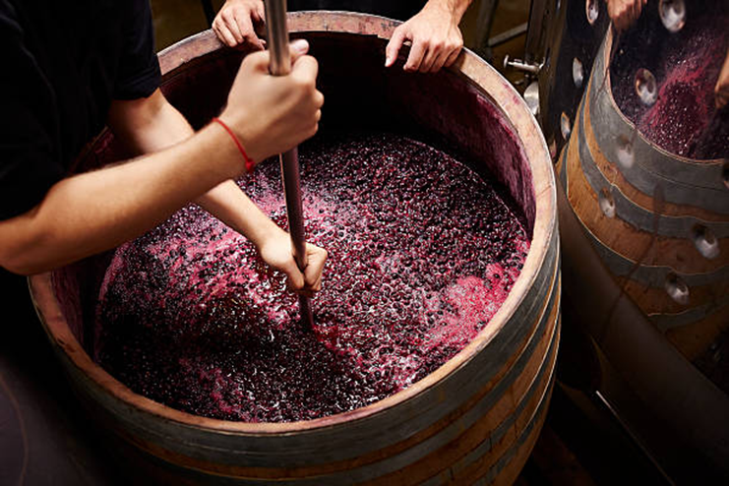
Summary
After experimentation and testing, we found that certain models were more accurate to use than others.
We did find that certain models showed they were close in accuracy , but we were also limited in our own data sets.
Variables such harvest years, quality of grapes could have impacted our results to provide stronger correlations to quality.

